Slide 1
Advanced Developmental Psychology
PSY 620
Daniel Messinger, PhD

Slide 2
School Overview
School as a developmental context
Community effects
Childcare effects
@ 3, 4.5
Classroom composition (context) effects
Moderator: temperament?
Experiments: EHS RCT, HS RCT (Bierman), Abecedarian
@ 15, and end of high school
Cost-benefit analysis
Universal gifted screening (Card & Giuliano)
Context effects (Howes; Dmietreva

Slide 3
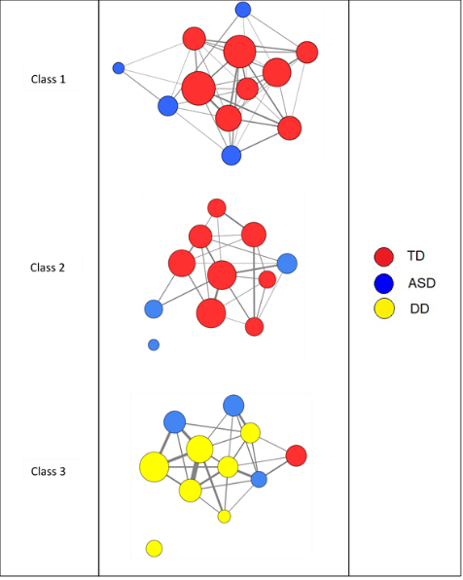

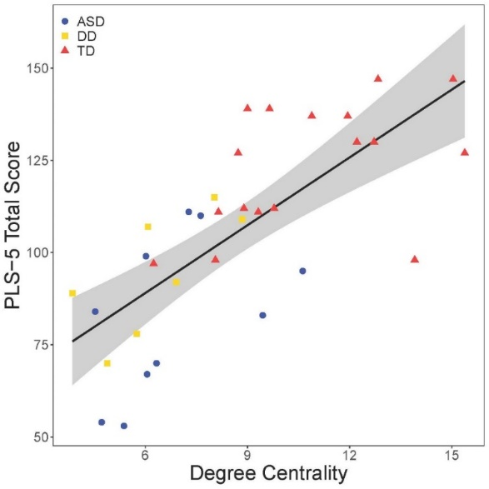
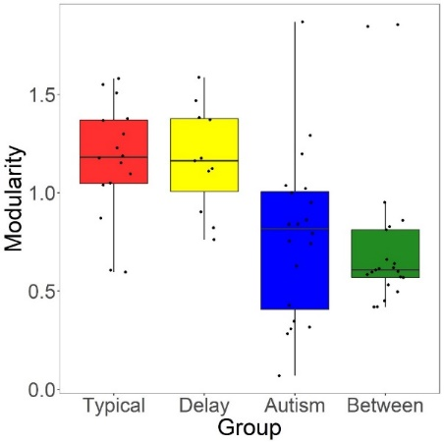
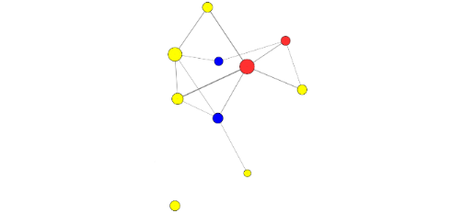
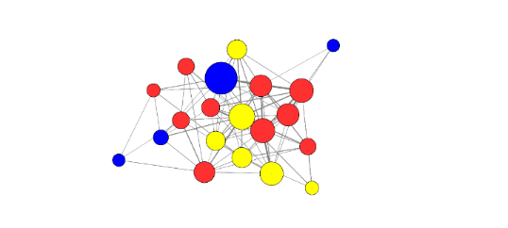
Reduced ASD degree centrality → language abilities
Centrality: ps < .026, ASD/TD: ps < .015, ASD/DD: ps > .05

Slide 4
Preschool as a multilevel context
Classroom Practices
Curriculum Content
Instructional Design
School
Curriculum Policies
Demographics
Organization
Child
Classroom Engagement
Motivation
Self-Esteem
Achievement
Goals
Behavioral Interaction
External Relations
School, home,
community linkages
Teacher Characteristics
Beliefs
Instruction Techniques
Relationships with
students
Notes:
Hierarchical & interdependent levels of organization; further levels include district, state, nation; levels vary from proximal to distal
Effects on child are both direct and indirect; direct effect of cooperative learning practices/school policy on child’s self-esteem and achievement
Example of indirect: standardized testing (FCAT) changes instructional focus to drill and practice; which may be at odds with teacher’s own goals/beliefs; affects teacher’s motivation and then affects child’s performance and development
Dynamic interactions between levels
Processes change across children’s development—idea of goodness of fit with child’s stage (=developmentally appropriate practice)
Processes change at different school levels (e.g., declines in student well-being at transition to middle school)

Slide 5
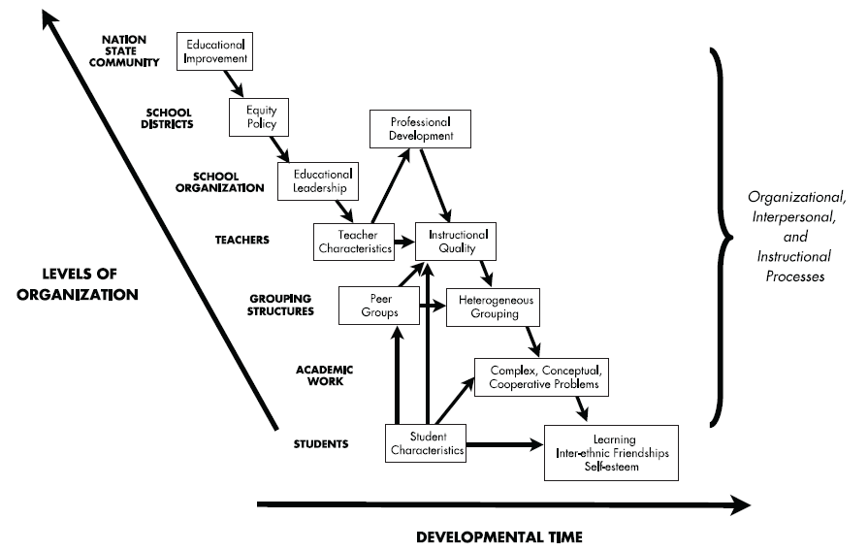
Levels of organization—1 (bottom) to 7 (top)
Hypothesized case: Heterogeneous grouping and complex instruction → increase educational equity
Broward gifted testing
2021 Bright Futures
direct and indirect effects
on child…

Slide 6
FL House Bill Law 1557
House Law 1557
“Parental Rights in Education” “Don’t Say Gay” bill.
Instruction on gender and sexuality would be constrained in all grades.
Lines 97-101: Classroom instruction by school personnel or third parties on sexual orientation or gender identity may not occur in kindergarten through grade 3 or in a manner that is not age appropriate or developmentally appropriate for students in accordance with state standards.
Schools would be required to notify parents when children receive mental, emotional or physical health services, unless educators believe there is a risk of “abuse, abandonment, or neglect.”
3/11/24: ORLANDO, Fla. (AP) — Students and teachers can discuss sexual orientation and gender identity in Florida classrooms, provided it’s not part of instruction, under a settlement reached Monday between Florida education officials and civil rights attorneys who had challenged a state law which critics dubbed “Don’t Say Gay.”

Slide 7
Individual level effects

Slide 8
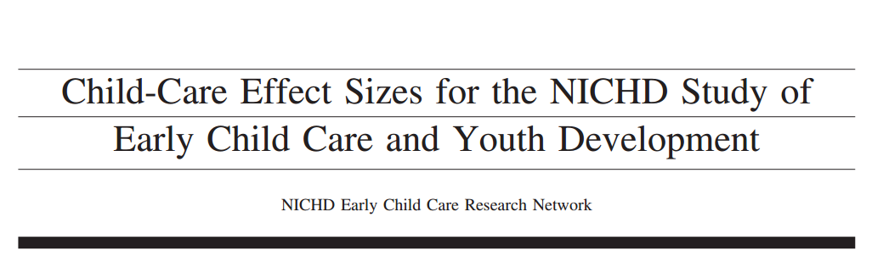
ADD TITLE SLIDE HERE!
Participants (N=1364)
(N=1,095 by 54 months)
24% ethnic minority
Assessed at 1, 6, 15, 24, 36, and 54 months

Slide 9
Background
Children attending child care has increased from under 25% to over 80%
This has generated questions about the effects of child care on children’s development
National Institute of Child Health and Human Development (NICHD) conducted a longitudinal study to observe these effects

Slide 10
Purpose of Study
To examine how variations in early child care experiences were related to children’s:
Social-emotional adjustment
Cognitive and linguistic performance
Health
Compare effect sizes for quantity, quality, and type of care with effect sizes of parenting

Slide 11
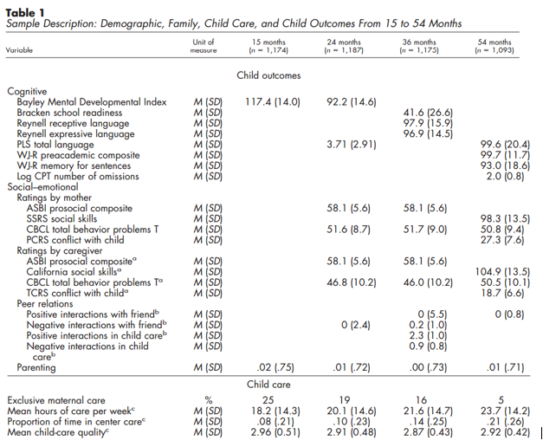
Measures

Slide 12
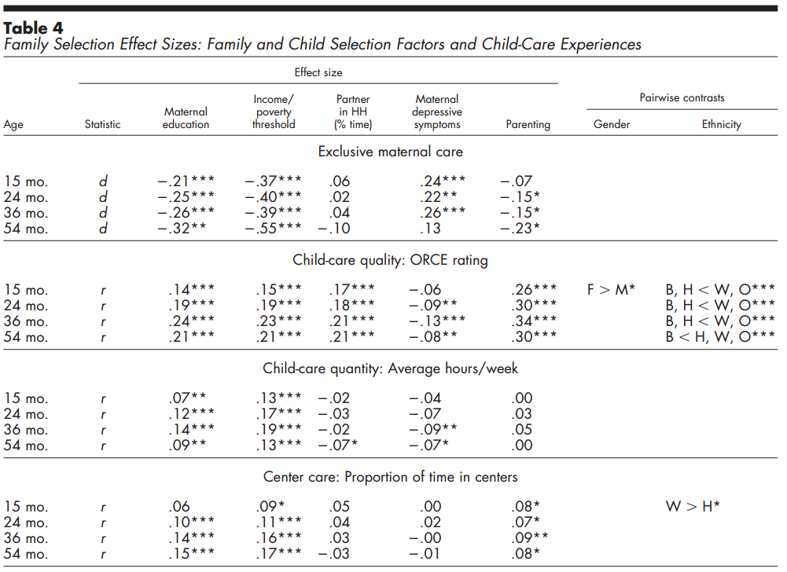
Family characteristics associated with child-care quality, quantity, & type: Center care (quality)—higher SES
INCLUDE TABLE 4 AND PUT BOXES AROUND FINDINGS WANT TO SHOW!

Slide 13
Child-care til 3 & peer competencies
More time in child-care →
more negative with playmates (caregiver rated)
more positive and skilled in peer play in child care (observed)
Child-care not associated with peer competence as rated by mothers or as observed in dyadic play with a friend.
Positive responsive caregiver behavior most consistently associated with positive skilled peer interaction
Maternal sensitivity, children's cognitive and language competence predicted peer competence across all settings and informants
family and child-care contexts may play complementary roles in development of early individual differences in peer interaction.
NICHD_Early_Child_Care_Research_Network (2001). "Child care and children's peer interaction at 24 and 36 months: The NICHD study of early child care." Child Development 72(5): 1478-1500
observed peer play not related to quantity of care.

Slide 14
Two and 3-year-olds in child-care
“more experience in child-care settings with other children present were … more positive and skilled in their peer play in child care
But their caregivers rated them as more negative with playmates.
Ss with more hours in child care rated by caregivers as more negative in peer play, but their observed peer play was not related to quantity of care.
Child-care experiences were not associated with peer competence as rated by mothers or observed in dyadic play with a friend.
Maternal sensitivity and children's cognitive and language competence predicted peer competence across all settings and informants.”
NICHD_Early_Child_Care_Research_Network (2001). "Child care and children's peer interaction at 24 and 36 months: The NICHD study of early child care." Child Development 72(5): 1478-1500.

Slide 15
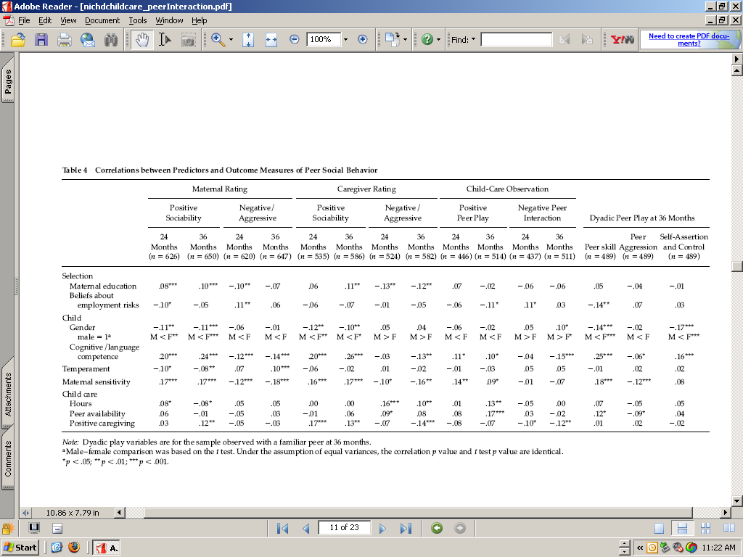

Slide 16
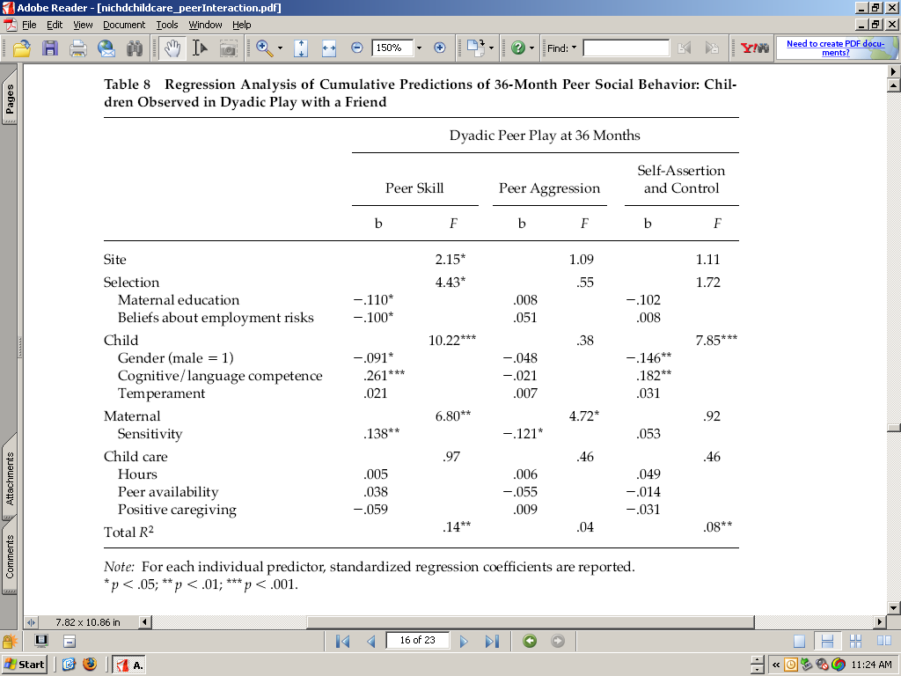
No child care effects on observed interaction
?

Slide 17
Exclusive maternal care did not predict outcomes
Higher quality child care related to higher cognitive, language, & pre-academic outcomes at every age
better socioemotional and peer outcomes at some ages.
More childcare hours --> more behavior problems and conflict, according to care providers.
More center-care time → higher cognitive & language scores
and more problem and fewer prosocial behaviors
according to care providers.
Children (n 1,261) were recruited at birth and assessed at 15, 24, 36, and 54 months.
Child-Care Effect Sizes through 4.5 years Early Child Care and Youth Development NICHD Early Child Care Research Network

Slide 18
Levels of analysis
Interactions
The braiding of two individual’s behavior
Relationships
“succession of interactions”
Friendship is a reciprocal, voluntary relationship based on affection
Groups – collection of interacting kids
Defined by cohesiveness, hierarchy, heterogeneity
Networks
The instantiation of all interactions in a classroom?

Slide 19
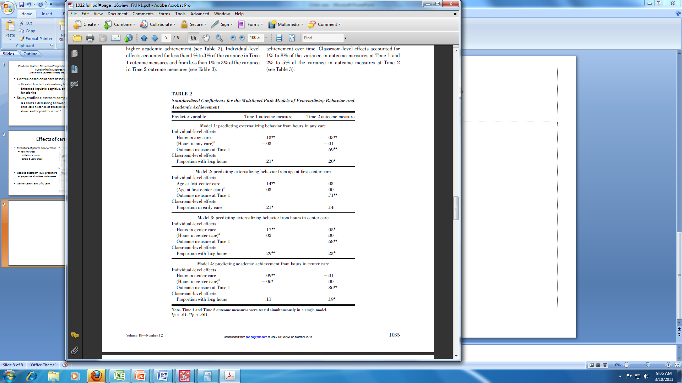
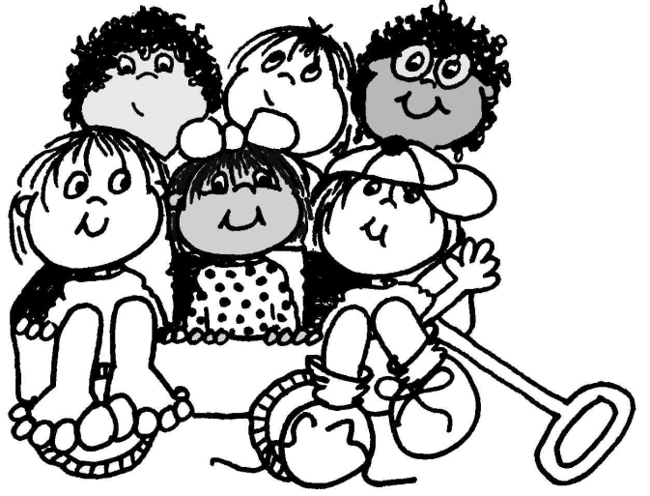
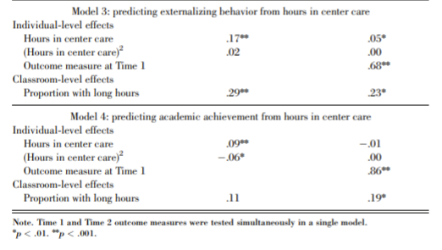
Classroom-composition effects
A child’s externalizing behavior is explained by the child-care histories of children in their classrooms above and beyond their own
Child-care History, Classroom Composition, and Children’s Functioning in Kindergarten. Dmitrieva, Steinberg, Belsky. 2007.
http://pss.sagepub.com/content/18/12/1032.abstract
Notes:
Peer contagion
Non-parental child care associated with
Elevated levels of externalizing behavior
Enhanced linguistic, cognitive, and academic functioning

Slide 20
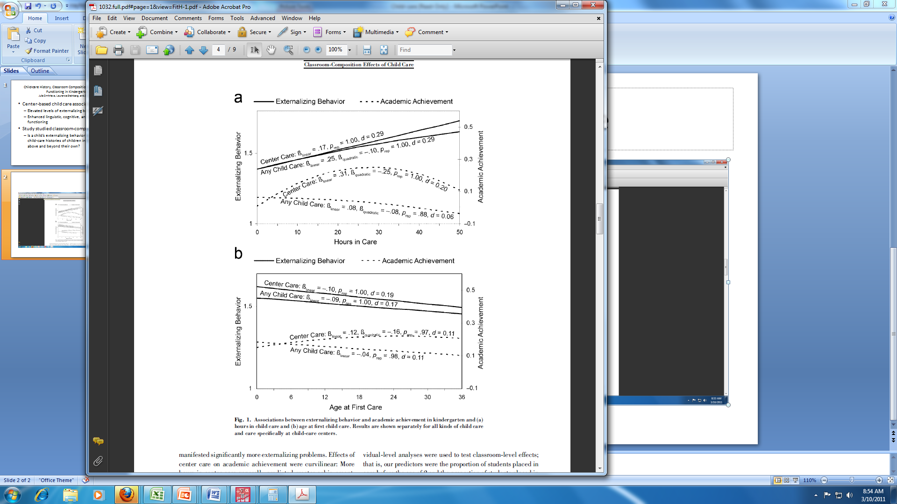
Individual effects of care
Predictors of poorer achievement
>30 hrs/week
initiation at center
before 2 years of age
Used as classroom level predictors
proportion of children in classroom
Center care versus any child care

Slide 21
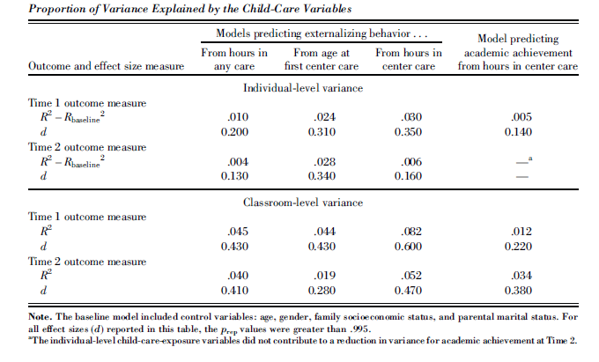
Classroom-level effects > individual effects (variance explained)
Variance in class-level characteristics
externalizing behavior
15% (T1) and 19% (T2) of variance
achievement
35% (T1) and 31%(T2) of variance
Significant classroom level effects

Slide 22
Early non-parental care affects children by affecting their peers
Being in a class with high proportion of students with child-care histories affects all children, independent of personal experience
“Interactions, relationships, and groups are mutually constitutive and have emergent properties.”
Notes:
Are effects amplified or attenuated over years of schooling?

Slide 23
Maternal Care and Parenting
Maternal care was not related to better or worse outcomes for children
Children with parents who were more responsive and stimulating had significantly higher cognitive, language, social-emotional, and peer outcomes

Slide 24
54 Month Outcomes

Slide 25
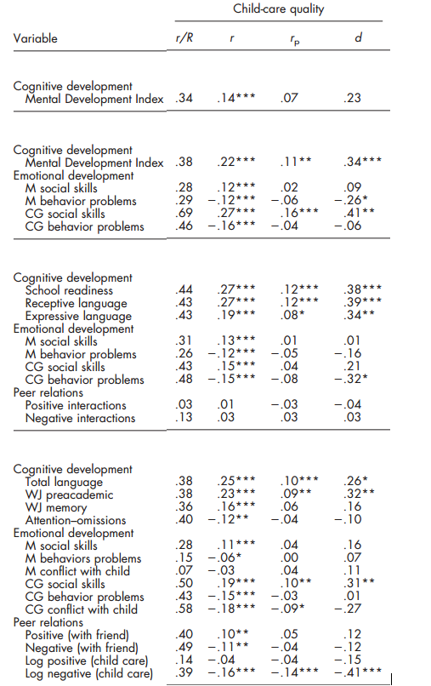
Child-Care Quality and Child Outcomes

Slide 26
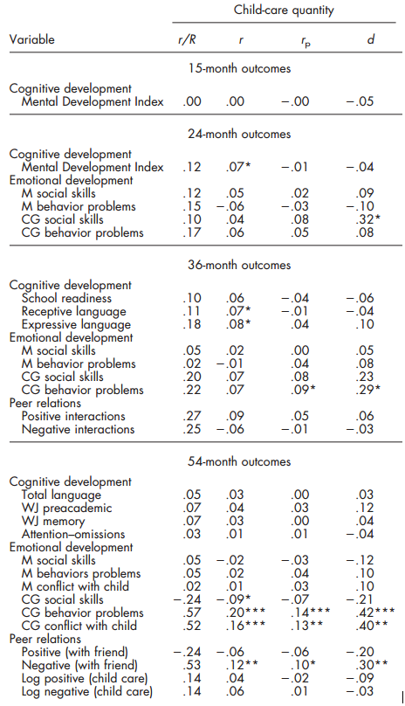
Child-Care Quantity and Child Outcomes

Slide 27
Conclusion
Parenting was a predictor of all child outcomes and matters more than child care
Quality, quantity, and type of care are related to children’s development
Exclusive maternal care not related to children’s outcomes

Slide 28
What makes a difference: Early head start evaluation findings in a developmental context john m. Love, rachel chazan-cohen, helen raikes, and jeanne brooks-gunn (2013)
Experiment
Miami
Randomized efficacy trial of 17 EHS programs
Federal Early Head Start (EHS) began in 1995
3,001 low-income families
35% African American, 24% Hispanic, and 37% White
pregnant women or an infant under the age of 12 months
Randomly assigned to treatment or control
91% of treatment group receiving some services
(1) impacts of EHS at ages 2 and 3 (when services were being offered) and at age 5, and (2) contributions of early education experiences across first 5 years
DOI: 10.1111/j.1540-5834.2012.00699.x

Slide 29
Early developmental effects
At 2 and 3 years, EHS benefited children and families: impacts were seen in all domains
effect sizes .10 -.20
At 5, EHS children had better attention, approaches toward learning, fewer behavior problems
But no effect on early school achievement
A higher percentage of EHS than control children were enrolled center-based preschool.
At 5, children and families who experienced EHS followed by formal programs fared best overall.
Notes:
age 5 cognitive impacts for African American children
language impacts for Hispanic children who spoke Spanish.
Some significant family benefits.
Earlier treatment effects on child cognition and engagement with parent contributed to age 5 effects

Slide 30
Supplementary analyses
A higher percentage of EHS than control children were enrolled center-based preschool.
Nonexperimental analyses suggested that formal program participation enhanced children's readiness for school while also increasing parent-reported aggression.
At 5, children and families who experienced EHS followed by formal programs fared best overall.
Notes:
Although fewer than half the children enrolled in center-based preschool programs between ages 3 and 4, almost 90% participated in the year preceding kindergarten
Benefits in language, behavior, and parenting were associated primarily with EHS; benefits in early school achievement were associated primarily with preschool attendance.

Slide 31
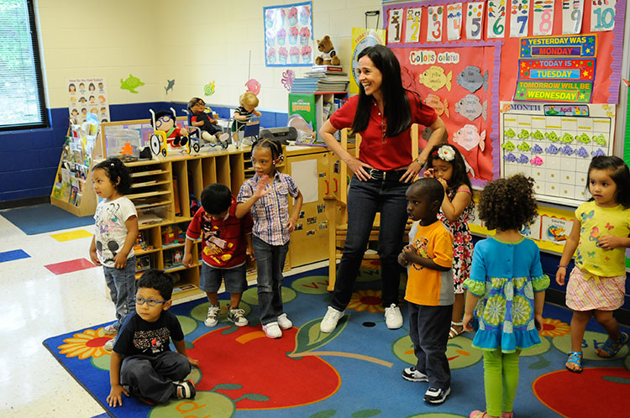
Background Information
Growing up in poverty = Delays in academic and social school readiness
The Head Start Program
Offers enriching early learning opportunities
Offers support for parents
Research Based Developmentally Informed (REDI ) Classroom Program
Designed to promote school readiness in Social-Emotional Development and Literacy skills

Slide 32
The REDI CLASSROOM PROGRAM
Prosocial Skills
Emotional Understanding
Self Regulation
Problem Solving
Preschool Promoting Alternative Thinking Strategies (PATHS) Curriculum
Offers teachers ways to support the growth of…
Contains Dialogical Reading Program
Randomized Controlled Trial Results
Showed gains in Social Emotional skills, social problem solving, literacy skills, and classroom engagement, and decreased aggression.
Results faded by the end of kindergarten
Helping Head Start Parents Promote Their Children’s Kindergarten Adjustment: The Research-Based Developmentally Informed Parent Program Bierman et al. (2015)

Slide 33

The CURRENT STUDY
Explored the impact of an enhanced and expanded version of the REDI classroom Program

Slide 34
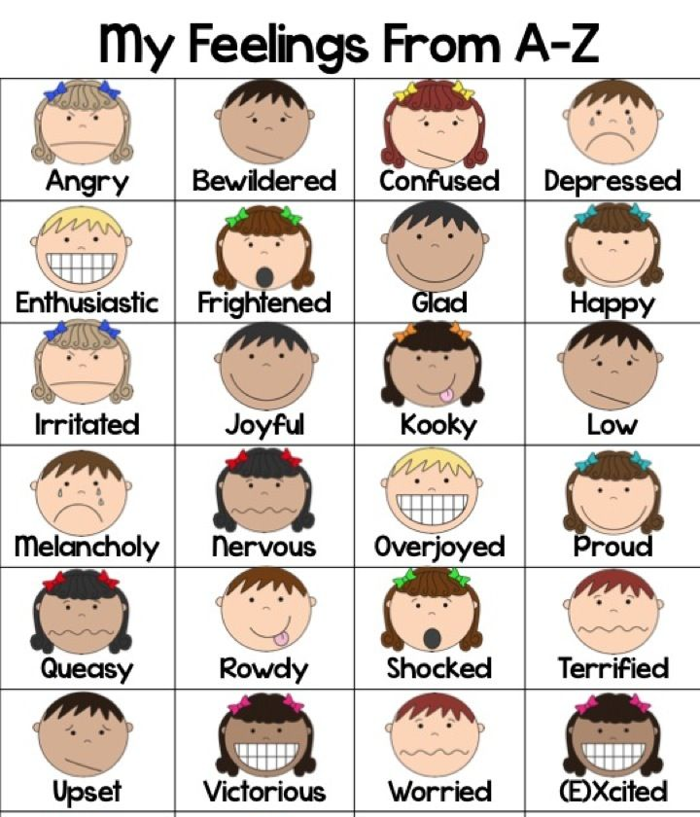
Research Based Developmentally Informed Parent Program (REDI-P)
1) Increased Home Visits
10 during Spring of preschool
6 during Fall of kindergarten
2) Enriched Visits
Evidence-based learning activities
Support strategies
All materials provided for parents
3) PATHS stories and Routines
Compliment Lists
Feelings Charts
”Turtle” to Calm Down

Slide 35
Participants
200 Children (55% European American, 26% African American, 19% Latino; 56% male), age 4.45 years old
Parents (39% single; 54% unemployed; median annual family income = $18,000)
REDI-P Intervention Group
Received 16 home visits
Control Group
Received 4 mail-home packets of parent-child math games
Pre-Intervention and Post-Intervention Assessments

Slide 36

Language and Literacy Skills
Expressive One-Word Picture Test
Assessed Vocabulary
Emergent Literacy Skills- Composite
Letter-Word Identification Scale
Letter Naming Fluency Subscale
Letter Sound Fluency Scale
Word Reading Efficiency Test
Assessed reading fluency
Teacher-Rating
12-item Academic Success subscale

Slide 37

Social-EMOTIONAL ADJUSTMENT
Self-Directed Learning
5 items from the School Readiness Questionnaire
5 items from the Learning Behaviors Scale
Prosocial Behavior and Emotional Regulation
13 Items from Social Competence Scale
Aggression
7 Items from the Teacher Observation of Child-Revised

Slide 38

Parent Support for learning
Parent Report
Video-taped Observation
In home observation

Slide 39
Data collection
Fall
Pre-K year
Spring
Pre-K year
During Kindergarten
End of Kindergarten year
Pre-Intervention Assessments
Intervention
(10 visits)
Intervention
(6 visits)
Post-Intervention Assessments
Language & literacy skills
Social-emotional adjustment
Parent support for learning
Parent engagement & program implementation
(after each home visit)
Language & literacy skills
Social-emotional adjustment
Parent support for learning
Lerner

Slide 40
DAta analysis: Covariates
To control for: | Covariates:
Baseline levels | Pre-intervention measures of each study outcome
Kindergarten school quality | School level achievement County Cohort
Child characteristics | Age Sex Race Aggression
Family context | Single parent status Caregiver depression symptoms Family income-to-needs ratio
Lerner

Slide 41
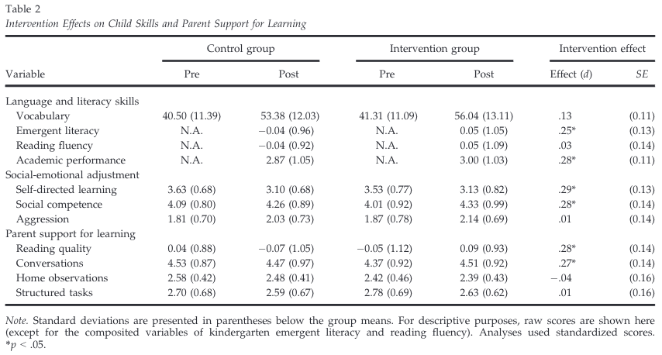
Intervention effects…for parent/teacher reported measures…
Direct assessment
Teacher rating
More self-directed in learning behaviors & more socially competent
Teacher rating
Parent report
More interactive reading & longer/more frequent conversations
Researcher observation
Lerner

Slide 42
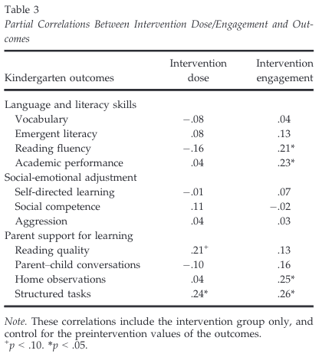
RESULTS
(# of visits received)
(home visitor rating)
Lerner

Slide 43
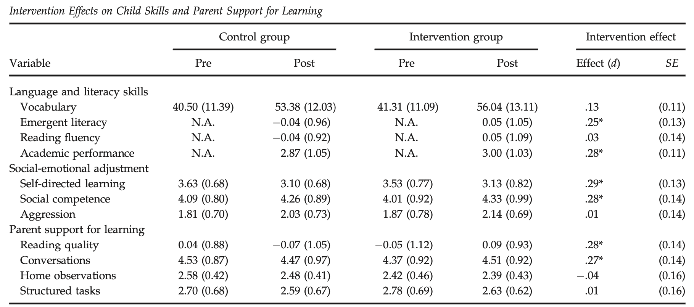
Range of effects

Slide 44
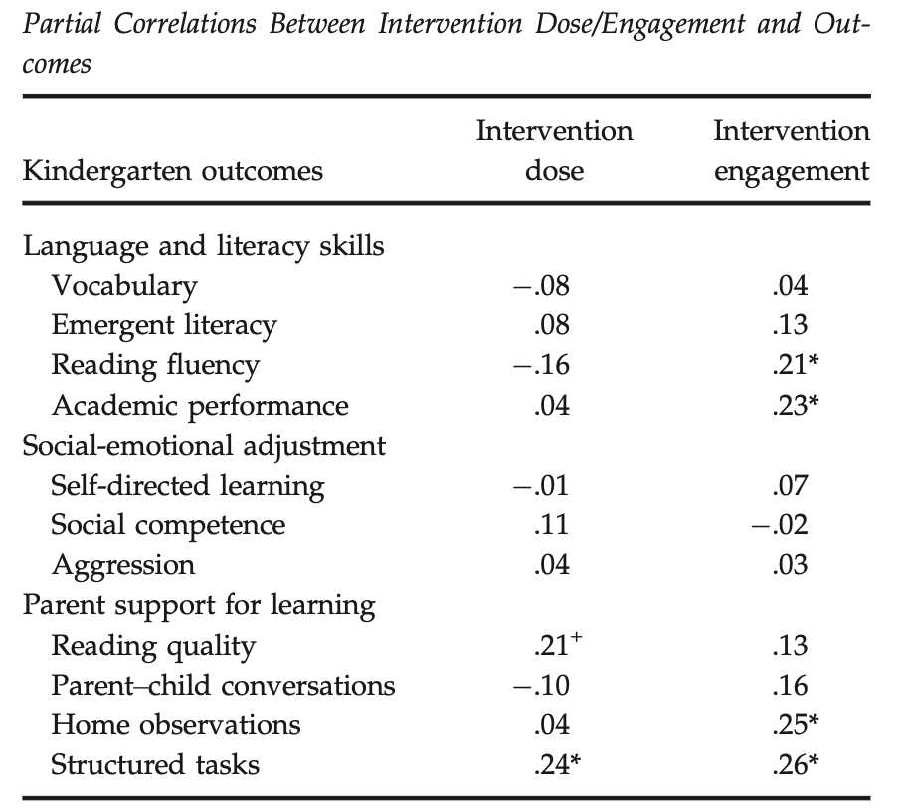
Results

Slide 45
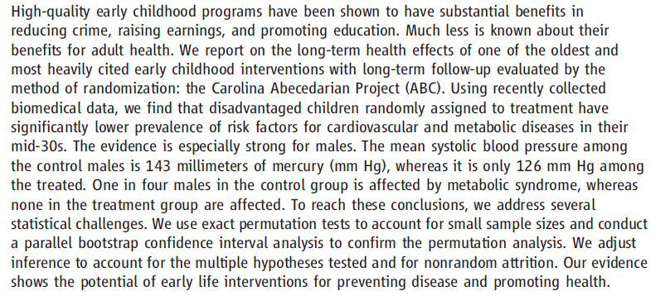
Early Childhood Investments Substantially Boost Adult Health (Campbell et al., 2014)
https://www.youtube.com/watch?v=8YyZ8FkFsK4
2:00-4:15
Maura, 2017

Slide 46
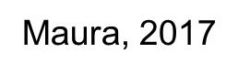
Background
Adult illnesses are more prevalent and problematic among those who have experienced adverse early life conditions
Interventions that enrich the environments of disadvantaged children have impacts on cognitive, social and schooling outcomes
But little is known about their benefits on health
Aim: Can high-quality, intensive interventions in the early years be effective in preventing or delaying the onset of adult disease?

Slide 47
ABC Intervention
Stage I: Early Childhood (birth – age 5)
Cognitive & social stimulation
Caregiving & supervised play
Nutritional/health component
2 meals/snack at childcare center
Primary pediatric care, periodic check-ups , & daily screens
Stage II: School-Age Stage (ages 6-8)
Focus on improving early math & reading skills via “home school resource teachers”

Slide 48
Method
122 children
Recruited in 1970s
Handpicked as part of “social experiment”
Children randomly assigned to stage I and then again to stage II

Slide 49
Measures
(birth – end of stage II)
Baseline
Child, parent, & teacher surveys
Direct assessments
Demographics (family structure, SES, birth circumstances)
Follow ups
Cognition, personality, health, achievement, behavior
Followed up again at 12, 15, 21, 30, mid-30s
Mid 30s: Assess cardiovascular & metabolic risk factors
Physical : weight, height, waist, hips, systolic & diastolic BP
Laboratory tests: blood collected during medical visit

Slide 50
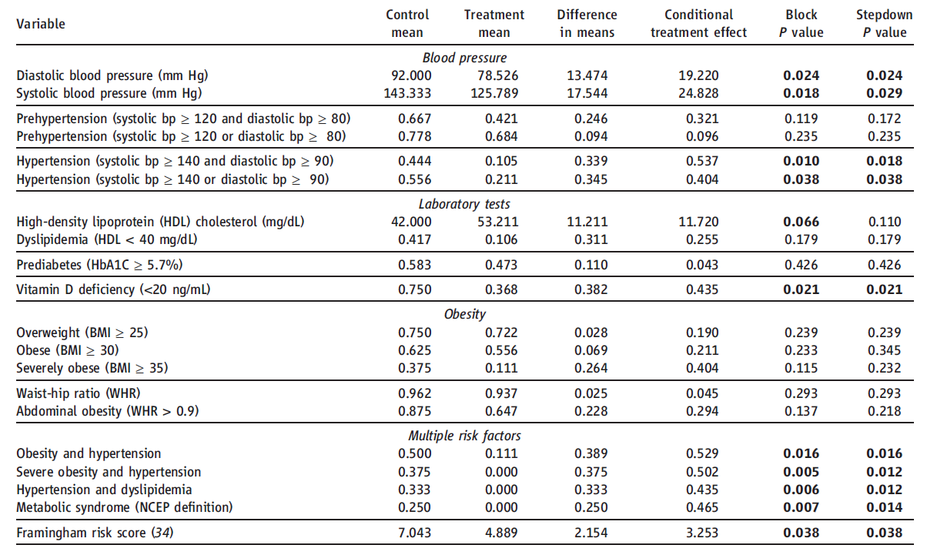
Results: Physical Health (Males)

Slide 51
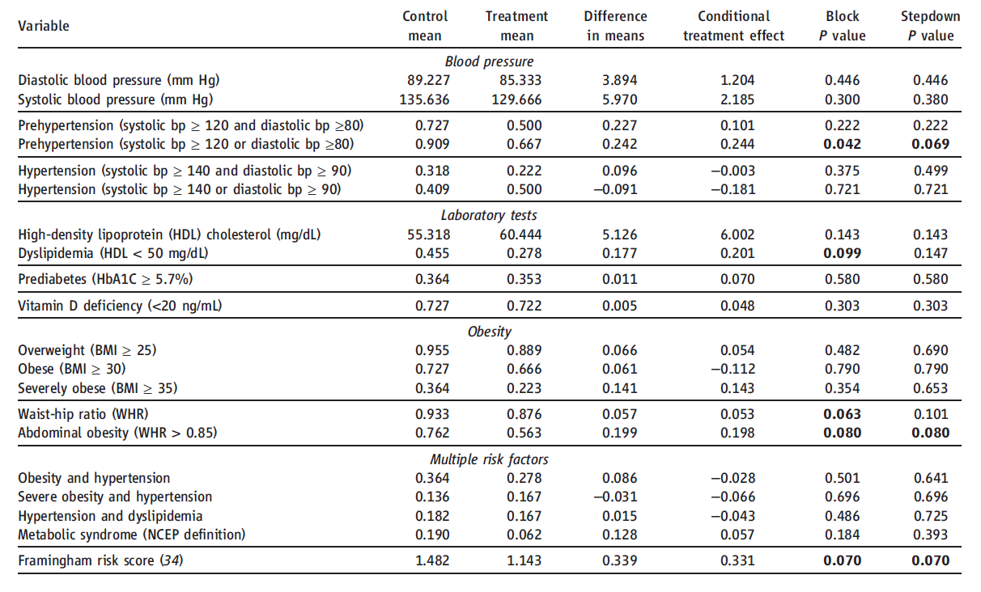
Results: Physical Health (Females)

Slide 52
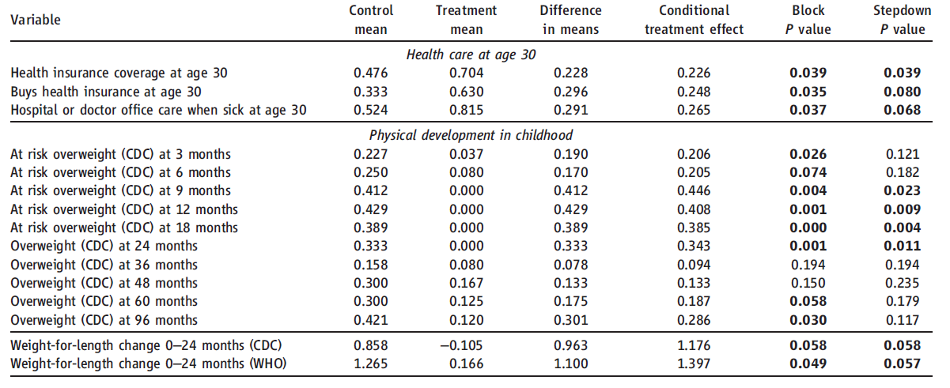
Results: Health Care & Physical Development (Males)

Slide 53
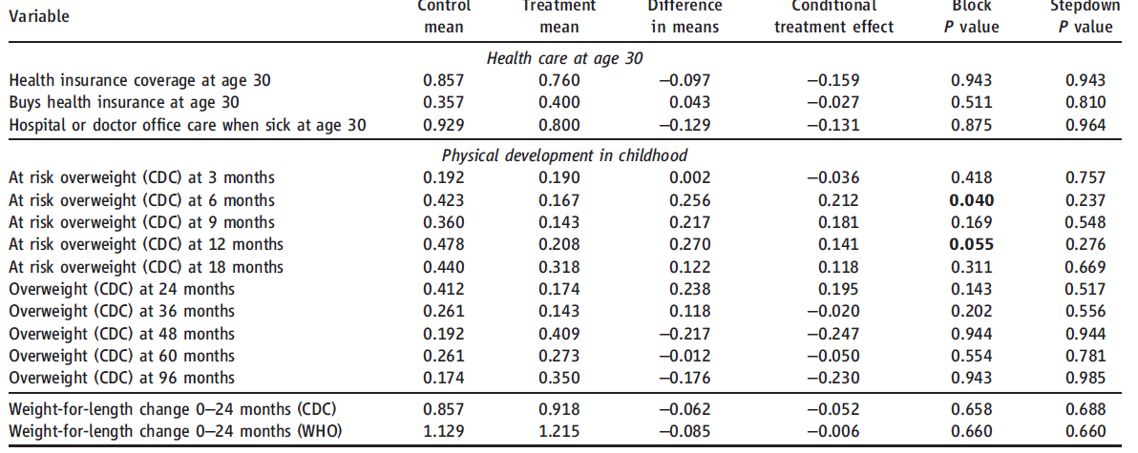
Results: Health Care & Physical Development (Females)

Slide 54
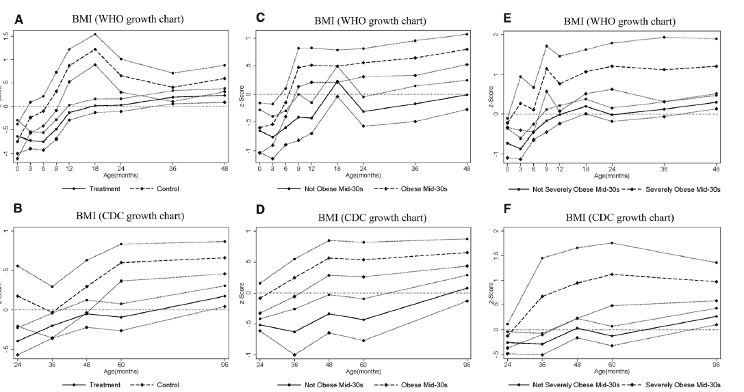
Results: BMI (Males)
BMI for males 0-4yrs
BMI for males 2-8yrs

Slide 55
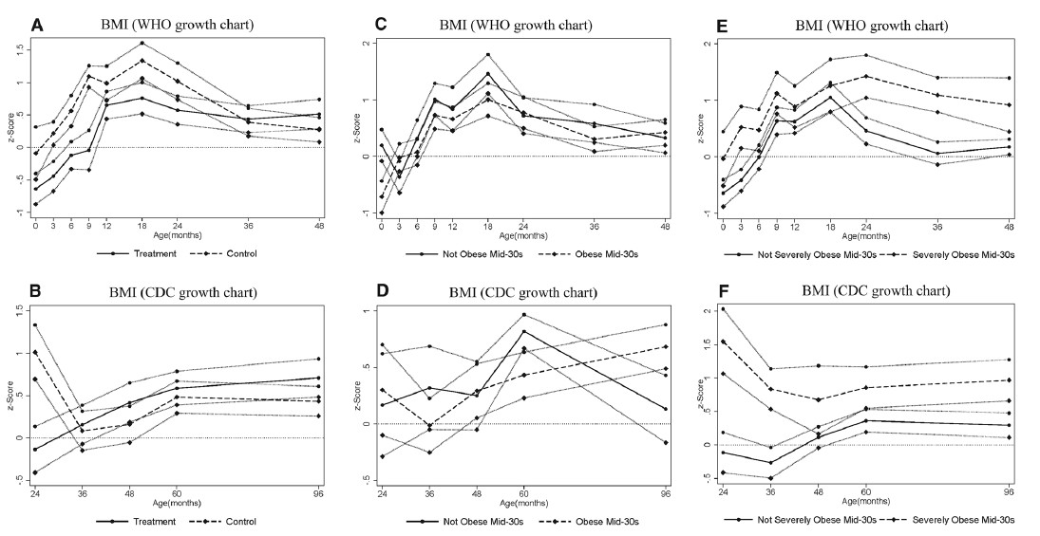
Results: BMI (Females)
BMI for females 0-4yrs
BMI for females 2-8yrs

Slide 56
Do you believe conclusions?
Children randomly assigned to the treatment group from ages 0 to 5 enjoyed better physical health in their mid 30s, with markers suggesting better future health
Highlights importance of intervening in the early years, suggests that early childhood programs can contribute to improving adult American health

Slide 57
Back to longitudinal effects

Slide 58
Aim
Extend previous research by examining the links between routine early child-care experiences and adolescent functioning in a large and economically diverse sample
Early child-care is thought of two ways:
Early child-care is associated with poorer social outcomes
Early child-care promotes social and academic skills before entry to kindergarten
Notes:
Research supports both viewpoints:
Experimental studies of high-quality early intervention programs can enhance social, cognitive and academic development of economically disadvantaged children
Higher quality child care is associated with better cognitive and academic outcomes
Viewpoint: Early childcare causes attachment issues and disruptive behavior problems
More time in center-type settings has been related to negative social and behavioral outcomes but potitive academic outcomes
Main take-away: In general, higher quality of child care was related to higher cognitive-academic performance, whereas more hours of child care (especially by non-relatives) was related to more behavior problems.

Slide 59
Method
1,364 families were randomly selected from the National Institute of Child and Human Development Study of Early Child Care and Youth Development (NICHD SECCYD)
Demographics:
26% of the mothers had no more than a high school education
21% of families had incomes no greater than 200% of the poverty level
22% were a minority
Notes:
Part of the National Institute of Child and Human Development Study of Early Child Care and Youth Development (NICHD SECCYD)
Families had to speak English
Were recruited from 10 locations in the U.S.

Slide 60
Measures
Construct | Measure | Time Points
Child-care type (type of child care arrangement: home-based care, father care, grandparent care) | Telephone and personal interviews with the mother | Every 3 months until the child reached 36 months and every 4 months until the child was 54 months
Child-care hours | Amount of hours per week child was in non-maternal care | 6, 15, 24 ,36, and 54 months
Child-care quality | Observational Record of Caregiving Environment (ORCE) | 6, 15, 24 ,36, and 54 months
Cognitive-academic achievement | Woodcock-Johnson Psycho-Educational Battery Revised | 54 months, 1st Grade, 3rd Grade, 5th Grade, Age 15
Risk Taking | Audio computer-assisted self-interview | Age 15
Impulsivity | Questionnaire | Age 15
Externalizing Problems | Teacher Report or Youth Self-Report | 54 months, 1st Grade, 3rd Grade, 5th Grade, & Age 15 (YSR)
Notes:
Child-care type- telephone and personal interviews (3 month intervals) to 4.5 years of age; moms reported types and hours of regularly used nonmaternal care; mom’s reported all of the care arrangements used since the previous interview; center, child-care home, in-home care, father care, or grandparent care. If child received at least 10 hours a week of that type of care it represented the type of care
WJ-
54 months and 1st grade: letter-word identification
3rd and 5th grade: broad reading (passage comprehension), applied problems (analyzing and problem solving in math), picture vocabulary (children’s ability to name objects)
age 15 Picture vocabulary and verbal analogies

Slide 61
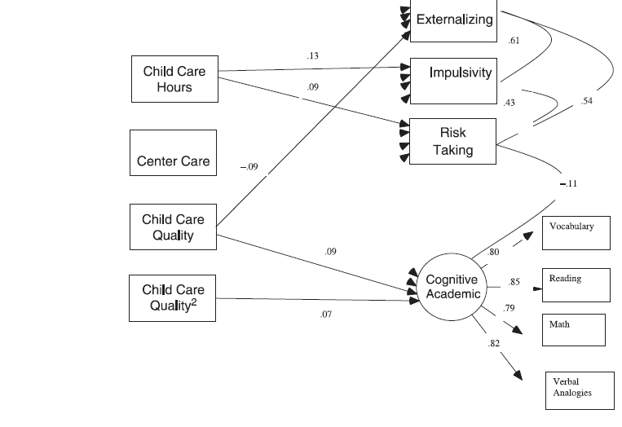
Child-care quality, quantity and type predict to 15 years
Notes:
Child care quality showed significant associations with children’s cognitive-academic achievement at age 15.
Children who experienced higher quality care had significantly higher levels of cognitive-academic achievement at age 15
Child care quality was linked to academic outcomes for adolescents whose care on average was moderate quality or better, with the magnitude of the quality effects being larger at higher levels of quality
Higher quality care is associated with higher academic outcomes but and lower externalizing scores at age 15
Adolescents who experienced more hours of nonrelative child care across their first 4.5 years reported more risk-taking and greater impulsivity at age 15
Exposure to center care was not related to academic achievement or problem behaviors at age 15
More hours in non relative care predicted poorer social adjustment

Slide 62
Results: Quality, Quantity and Type as Predictors
Child-care quality showed significant associations with children’s cognitive-academic achievement at age 15
Children who experienced higher quality care had significantly higher levels of cognitive-academic achievement at age 15
Higher quality care is associated with higher academic outcomes and lower externalizing scores at age 15
Adolescents who experienced more hours of nonrelative child care across their first 4.5 years reported more risk-taking and greater impulsivity at age 15
More hours in nonrelative care predicted poorer social adjustment
Notes:
Child care quality was linked to academic outcomes for adolescents whose care on average was moderate quality or better, with the magnitude of the quality effects being larger at higher levels of quality
Exposure to center care was not related to academic achievement or problem behaviors at age 15

Slide 63
Academic Achievement as Mediator through time
The observed association between child-care quality and age 15 cognitive-academic achievement can be explained at least partially by the association between child-care quality and academic skills at entry to school, which are then maintained into high school
Notes:
The observed association between child-care quality and age 15 cognitive-academic achievement can be explained at least partially by the association between child-care quality and academic skills at entry to school, which are then maintained into high school

Slide 64
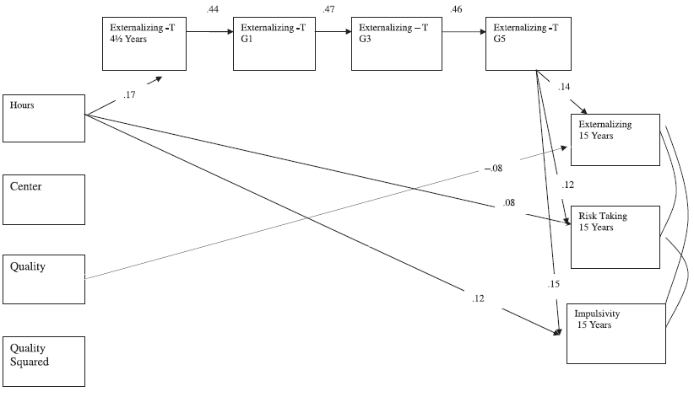
Problem behavior as mediator through time
Notes:
Higher hours spent in childcare significantly predicted higher risk taking behaviors and impulsivity at 15 years.
Modest levels of mediation when looking at the association between hours spent in childcare and externalizing behavior problems mediated by behavior problems beginning at 4.5 years old through 5th grade
This may be due to the changing informant of behavior problems. First the caregiver, then teacher (who switches) and then adolescent self report.
Higher quality non-relative childcare significantly predicted less externalizing behaviors at age 15.

Slide 65
Results: Problem Behavior as a Mediator
Higher hours spent in childcare significantly predicted higher risk taking behaviors and impulsivity at 15 years of age
There were modest levels of mediation when examining the association between hours spent in childcare and externalizing behavior problems at age 15
May be due to the informant changing
Higher quality non-relative childcare significantly predicted less externalizing behaviors at age 15

Slide 66
Discussion Questions
If early child-care quality predicts greater cognitive-academic outcomes and hours spent in child-care predicts more externalizing problems at age 15, how do you find the right balance of child-care that produce the best outcomes?
Notes:
Why do you think time spent in child-care and quality of child-care were better predictors of adolescent outcomes than type of child-care?

Slide 67
Early child care quality predicts cognitive-academic achievement
Moderate to high quality child-care produces the greatest long term effects
Quality of early child care experiences have long lasting effects on all children despite SES
Higher quality nonrelative childcare is related to less externalizing behavior at age 15
More hours in child care and more center-type care → higher levels of behavior problems in children
The link between child care, cognitive-academic outcomes, and problem behaviors is consistent over 10 years

Slide 68
Moderation?

Slide 69
Link between quality of care & problem behavior… Diathesis-stress or differential susceptibility?
Higher quality childcare is associated with better cognitive and academic outcomes
Diathesis-stress – highly negative children will suffer in low quality environment
Differential susceptibility - less negative children will thrive in higher quality environment
Poodle vs. Retrievers
Orchids vs. Dandelions
Notes:
Prior research has shown that higher quality childcare is associated with better cognitive and academic outcomes. High quality child care is seen as enviorments in which caregivers are attentive, responsive, stimulating and positive and not negative, neglectful or intrusive.

Slide 70
Study Aim
Does difficult temperament in infancy continue to moderate effects of childcare quality on problem behavior in adolescence (15 years)?
842 total participants
NICHD SECCYD
Notes:
So in this study they were looking to determine whether difficult temperatment in infancy continues to moderate effects of child care quality on problem beahvior in adolescence (so at age 15 here)
Methods wise, they are trying to understand whether these earlier detected differential suceptibility effects continue when measurement is changing from caregiver and teacher report to now adolescent report.
So for this study, they had a total of 842 participants and all of this was through the Study of Early Child Care and Youth Development from the National institiute of child health and human development.

Slide 71
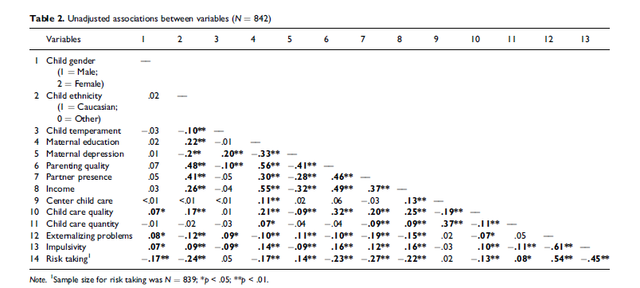
Measures
Notes:
Bivariate correlations between study variables
Child temperament associated with externalizing behavior problems
So this is one of the results table, but it shows all the measures that were completed in this study.
In terms of predictor variables, they measured child temperament and child care quality. Child temperament was measured by maternal report at 1 and 6 months using an adapted version of the infant temperament questionaire. Child care quality was measured through observational assessments in the primary child care arrangement at ages 6, 15, 24, 36 and 54 months
In terms of outcomes, they measured externalizing problems, risk taking and impulsivity. For externalizing behaviors, they had adolescents self-report externalzing behaviors using the Youth Self-Report. Risk taking was measured through adolescent report as well in which they reported risk taking behaviors using an audio computer assisted self interview. And they measured impulsivity through adolescent self report asl well in which they completed an 8 item survey to assess reactions to external constraints.
They also included a number of covariates including family background factors such as income, child gender, child ethnicity, maternal education, maternal depression and presence of a partner. They also measured parenting quality based on ratings of maternal sensitivity during 15 minute videotaped interactions at 6, 15, 24, 36 and 54 months and scoares of the Home Observation for Measurement of the Eniornment at the same ages. They also looked at the type of care in which tye classiefied it as a center, child care home, in home care or grandparent care or father care. And lastly they looked at child care quanitity in which they had parents provide info on the hours of routine nonmaternal care during phone and personal interviews

Slide 72
Results
Externalizing behavior problems were greater for females, single parent homes
Greater risk-taking :
Males, non-Caucasian ethnicity, lower family income, higher proportion of partner absence
Greater Impulsivity:
Lower family incomes, greater exposure to any non-maternal child care in early childhood years
Notes:
There were a bunch of results. So first, externalizing prolbmes were greater when children were female and when they lived in a single parent home. Greater risk taking was singificantly associated with male gender, non-caucasian ethnicity, lower family income and higher proportion of partner absence. And greater impulsivity was predicted by lower family income and greater exposure to any nonmaternal child care

Slide 73
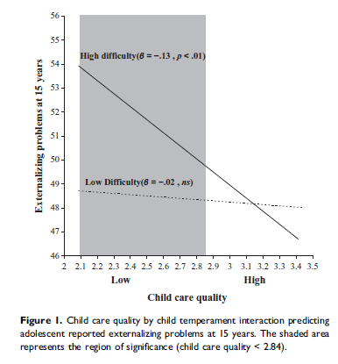
Difficult temperament→externalizing only in low childcare quality
Diathesis stress model
Externalizing problems only significant when childcare quality was less than 2.84
Higher scores reflect children’s experience with caregivers who were more attentive, stimulating, positively affectionate, less intrusive and negative
Orchids vs. Dandelions?

Slide 74


Slide 75

Background
~50% of infants/toddlers and > than 75% preschoolers experience regular nonparental child care (Burchinal et al., 2015)
High-quality, early care and education improves early cognitive and social skills
Notes:
Based on studies involving children from low-income families enrolled in model programs

Slide 76
Purpose of Study
The purpose of the current study is to examine if participation in early child care settings predicts end of high school (EOHS)
Academic outcomes
Social outcomes
Extend previous research by examining the links between routine early child-care experiences and later outcomes in a large and economically diverse sample
Notes:
The purpose of the current study is to examine the extent to which participation in more typical early child care settings predicts academic and social outcomes at the end of high school (EOHS) in a large, economically diverse sample that includes children from middle-income families as well as highincome and low-income families.
Much less research has considered links between ECE experiences in typical early care settings and functioning in early adulthood for children from economically diverse families
The current study extends the examination of early child care experiences and adolescent functioning to the EOHS and considers standard measures of academic standing and behavioral indicators

Slide 77
Methods
Sample:
NICHD Study of Early Child Care and Youth Development (SECCYD): (n= 1,364 families)
Sample at 15 years (n =1,002)
End of high school (EOHS) (n =779)
Notes:
The NICHD Study of Early Child Care and Youth Development (SECCYD) is one of the few longitudinal studies that can address this issue with a large sample that includes low-, middle-, and high-income children. Launched in the early 1990s to examine the effects of early child care, the SECCYD included 1,364 participants recruited at birth in 10 sites in the United States. In a series of reports, relations were considered between early child care and child functioning prior to school entry, in early elementary school, in later elementary school, and at age 15 years

Slide 78
Methods
EOHS measures of academic standing: typical grades, advanced coursework, class rank, and selectivity of the postsecondary institutions that young people plan to attend.
EOHS measures of social outcomes: social, emotional, and behavioral competencies
Covariates: as a potential moderator of relations between early child care and functioning
Early childhood: Gender, race/ethnicity, maternal education (in years); maternal vocabulary Peabody Picture Vocabulary Test, mother NEO Personality,
Early, Middle, and Adolescent Covariates: maternal depressive symptoms, observed maternal sensitivity, income-to-needs ratio, and presence of a husband or partner in the household.
Unique to middle: quality of school experiences
Notes:
We also considered gender as a potential moderator of relations between early child care and functioning at the EOHS
Females receive higher academic marks in high school and college (Voyer & Voyer, 2014), and they graduate from high school and college at higher rates (Buchmann & DiPrete, 2006), whereas males engage in more risk-taking (Byrnes, Miller, & Schafer, 1999) and externalizing behaviors

Slide 79
Measures
HOME Home Observation of the Environment
WJR Woodcock-Johnson
PLS Preschool Language Scale
CBCL Child Behavior Checklist
Outcomes:
EOHS measures of academic standing:
Grades
Advanced Coursework
Class Rank
Plans after high school
Selectivity of College
Behavioral adjustment
Delinquent Behavior and Aggressive Behavior scales: Adolescents self-reported externalizing behaviors
Report of risk-taking behaviors
Weinberger Adjustment Inventory: reactions to external constraints
Notes:
Their responses were as follows: “I do not plan to get any further education beyond high school” (n 7); “I will eventually go to college, but first I will take some time off from school” (n 60); “I plan to join the military” (n 15); “I have joined the military” (n 11); “I plan to go to a trade school or technical school” (n 35); “I plan to go to a 2-year community college program” (n 123); and “I plan to go to a 4-year college program” (n 518). If

Slide 80
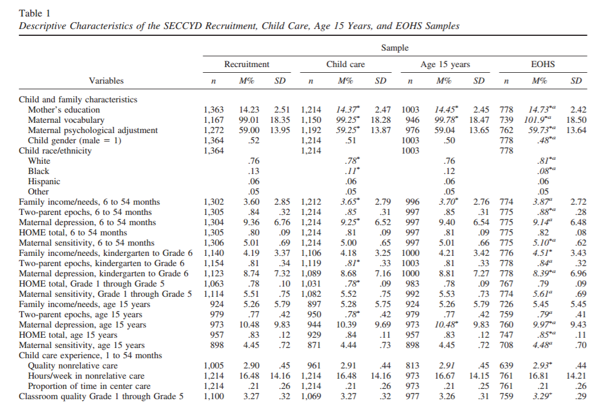
Measures
Moderators
Predictors

Slide 81
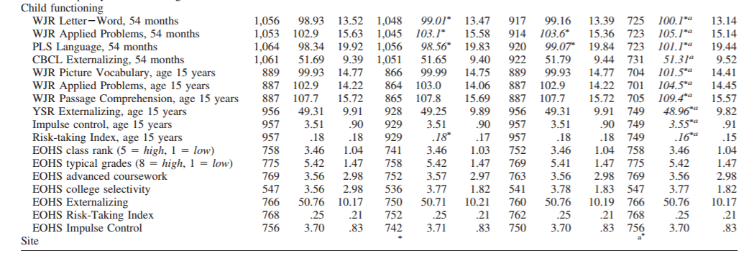
Measures: continued
Outcomes

Slide 82
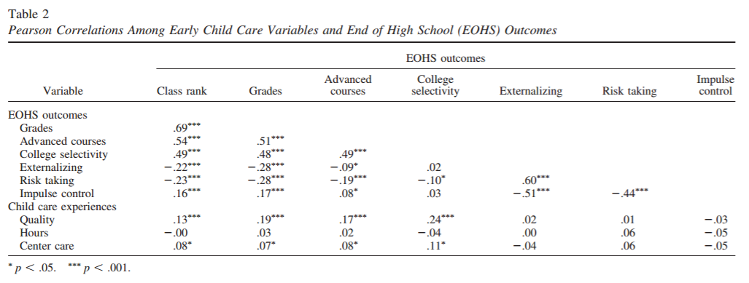

Child care quality correlated with End Of HS (EOHS) outcomes
*Hours in child care NOT correlated with outcomes

Slide 83
Care quality…
Higher child care quality and more center-type care were correlated with higher class rank, higher grades, more advanced coursework, and plans to attend more selective colleges.
Amount of time in early child care was not correlated with the measures of end of high school (EOHS) academic standing or behavioral adjustment.

Slide 84
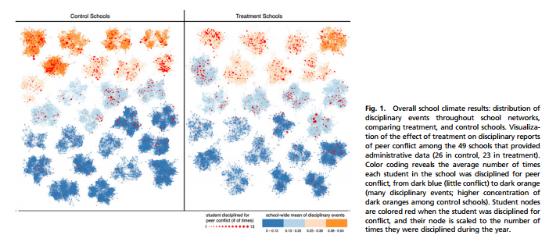
Disciplinary reports of student conflict at treatment schools reduced by 30% over 1 year
56 schools with 24,191 students.
Paluck et al., 2015 | Roddy, 2017

Slide 85
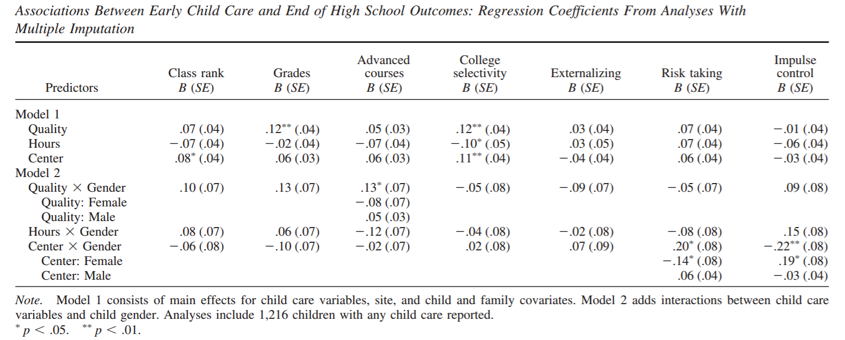
Are There Relations Between Early Child Care and Adolescent Outcomes at the EOHS?
*None of the early child care variables were related to the behavioral adjustment measures at the EOHS.
Notes:
Quality: higher academic grades and plans to attend more selective colleges
Adolescents with fewer hours in child care reported plans to attend more selective colleges
more center-type child care reported higher and College selectivity

Slide 86
Are There Relations Between Early Child Care and Adolescent Outcomes at the EOHS?
Quality: higher academic grades and plans to attend more selective colleges
Adolescents with fewer hours in child care reported plans to attend more selective colleges
More center-type child care reported higher and College selectivity
Notes:
Quality: higher academic grades and plans to attend more selective colleges
Adolescents with fewer hours in child care reported plans to attend more selective colleges
more center-type child care reported higher and College selectivity

Slide 87
Are relations between early child care and EOHS outcomes were moderated by gender?
*No significant interactions between early child care hours and gender were found for EOHS academic standing and behavioral functioning.
Notes:
Proportion of time in center care was differentially related to risk taking and impulse control
More epochs in center care was associated with less risk taking and greater impulse control for females but not for males
Higher quality care was positively, but nonsignificantly, related to reports of number of advanced courses for males and negatively, but nonsignificantly, related for females

Slide 88


Are relations between early child care and EOHS outcomes moderated by gender?
Girls who had more experience in center type care reported engaging in fewer risky behaviors and exhibiting better impulse control at the end of high school
Higher quality care was positively, but non-significantly, related to reports of number of advanced courses for males and negatively, but non-significantly, related for females
Notes:
Proportion of time in center care was differentially related to risk taking and impulse control
More epochs in center care was associated with less risk taking and greater impulse control for females but not for males
Higher quality care was positively, but nonsignificantly, related to reports of number of advanced courses for males and negatively, but nonsignificantly, related for females

Slide 89
Discussion
SECCYD reports more childcare hours predicted more behavior problems and conflict but not academic outcomes (not contradictory but opposite to this study)
NICHD ECCRN reports more center-care time was related to higher academic and cognitive performance
Limitations:
EOHS was more privileged
SECCYD sample is not nationally representative
Notes:
These findings are at odds from the SECCYD reports at earlier ages when higher hours of care were linked to more externalizing behaviors, but not to academic outcomes.
They are, however, with consistent with the longitudinal research by Masten and colleagues (2005) who observed developmental cascades in which higher externalizing behaviors in middle childhood predicted lower academic competence in adolescence.

Slide 90
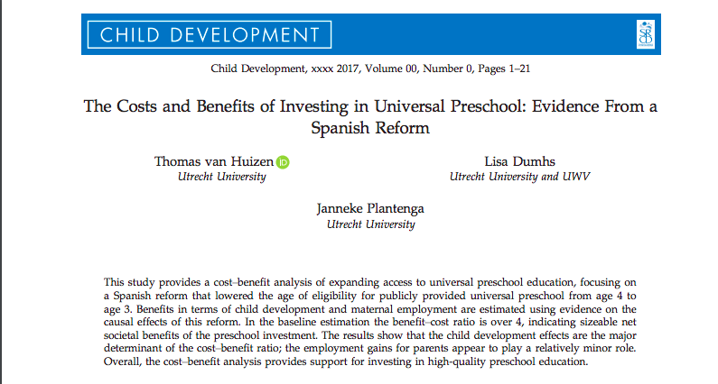
Cost-Benefit Analysis of Universal Preschool

Slide 91
Why publicly funded universal preschool?
Most children in developed countries receive early childhood education care (ECEC)
Universal preschool offered for age > 3 in several European countries & increasingly in U.S. (OK, GA, NYC)
Florida offers free prekindergarten to all 4-year-olds.
Voluntary Prekindergarten
Main arguments to justify investing in ECEC
(High quality) ECEC improves child development
School readiness & performance, social & cognitive outcomes in adulthood
Availability of ECEC may increase parental employment
Affordable childcare allows parents to return to work--> high (female) employment

Slide 92
Cost-Benefit Analysis of Universal Preschool
Evidence on cost-effectiveness of ECEC programs comes from studies which evaluated targeted programs for disadvantaged children, show promise (e.g., 1 dollar invested yields 7-12 dollar return)
Targeted programs do not generalize to universal programs well, leading to biased estimates of monetized benefits
Natural experiments based on policy reform required to study causal impact of ECEC programs on child development & maternal employment
AIMS:
To examine the extent to which benefits for children (developmental) + benefits for parents (employment) outweigh the costs (public investment) of universal preschool)

Slide 93
Universal Preschool from a Natural Experiment - LOGSE
Spanish Ley Organica de Ordenacion General del Sistema Educativo (LOGSE) reform (implemented 1990s)
Expanded coverage for universal preschool to age 3-yrs
Fully subsidized
Increased public preschool rates from 8.5% (1990) -> 67% (2002)
Addressed quality of preschool service
Curriculum
Group size
Staff educational requirements

Slide 94
Causal effects of universal preschool (quasi-experiment)
Difference in differences (DD) approach (compared high- to low-intensity regions)
From 8.5% in 1990 to 42.9% in 1997 and to 67.1% in 2002
Child development
Math & Reading scores from 2000-2009 waves of PISA standardized assessment (age 15)
Projected lifetime earnings= causal effect on scores * return to skills parameter (estimated increase in annual wage based on 1 SD increase in cognitive skills)
Reduced grade retention used to predict earlier labor market entry effect
Maternal Employment
DDD approach used to compare employment rates among mothers whose youngest child is 3-years (treatment) compared to 2- years (control)
“triple-difference” (DDD) model uses variation in the availability of universal preschool across women with children of different ages.

Slide 95
Methods: Cost-Benefit Analysis
Benefits
Treatment on Treatment (TOT) to estimate how causal effects→
Lifetime earnings for parents: return to work/ stay employed
Lifetime earnings for children: improved skill level/ enter workforce earlier
Gains for tax-payers: Taxpayers gain as gross earnings of children and parents increase
→ Gains for society: Dollars society receives back for every dollar invested in ECEC
Costs
Cost per child estimated from annual public expenditure per child for preschool/ primary education + average additional costs per child (supplies, etc) = $4,027

Slide 96
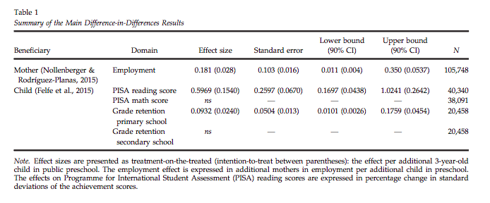
Mother employment and child score effects

Slide 97
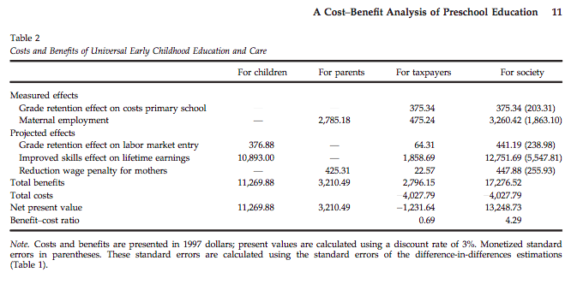
Cost-Benefit Analysis
^65% of benefits
Every $ invested in ECEC→ Society gains $4

Slide 98
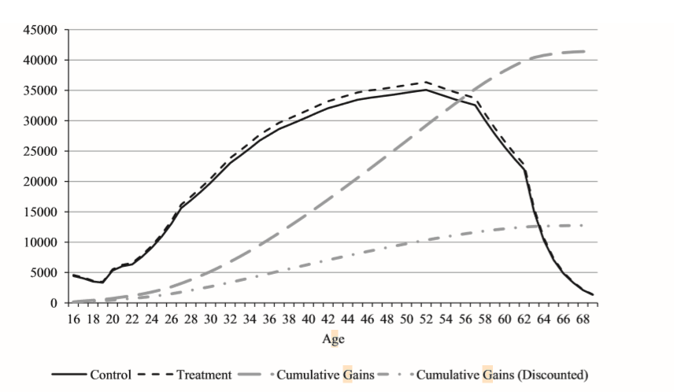
Its an investment: Cost-Benefit Analysis
Gains in gross lifetime earnings estimated at $12,751 by age 70 (discounted rate)

Slide 99
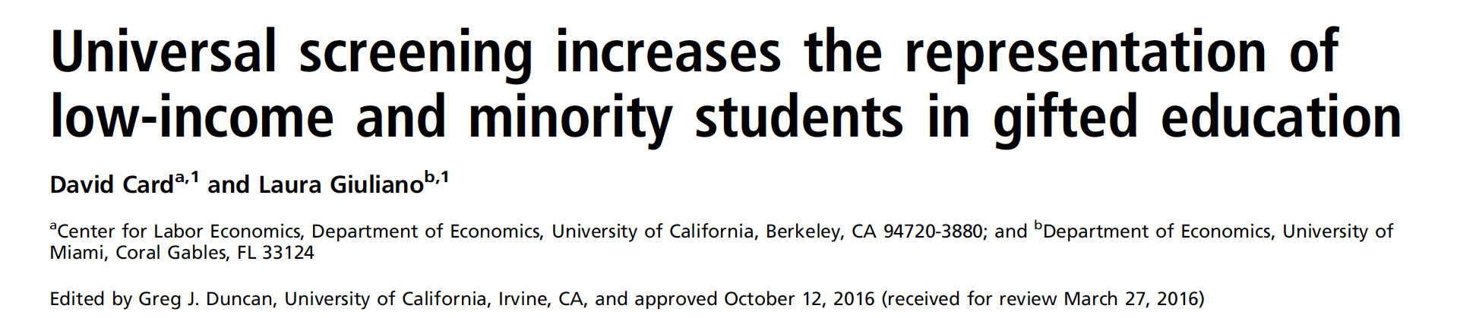
Kaitlyn Brodar

Slide 100
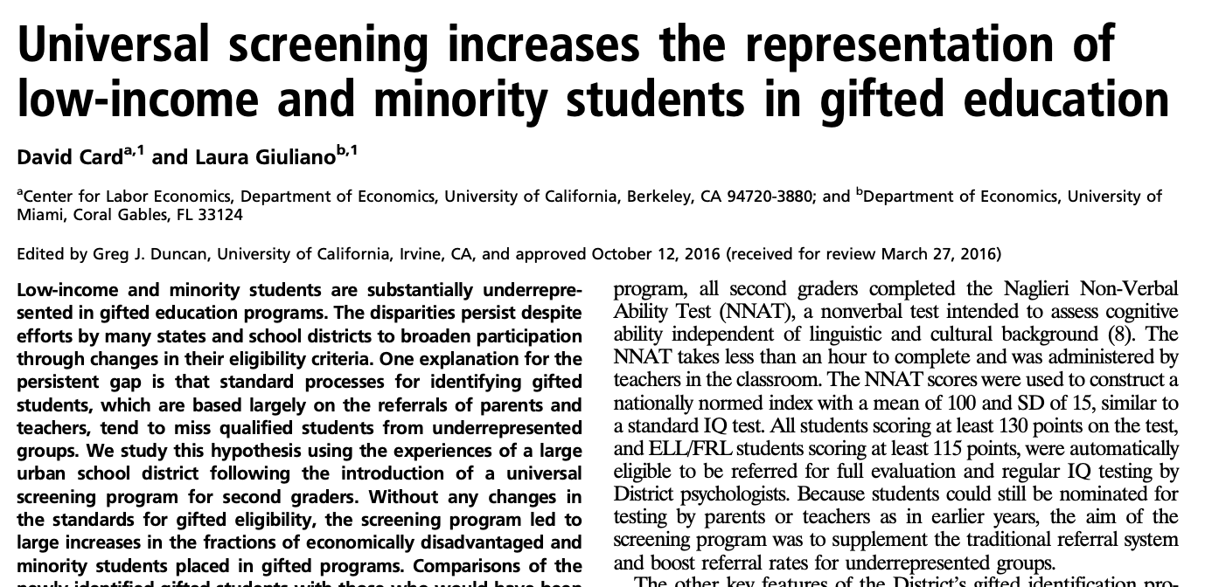
Mendez

Slide 101

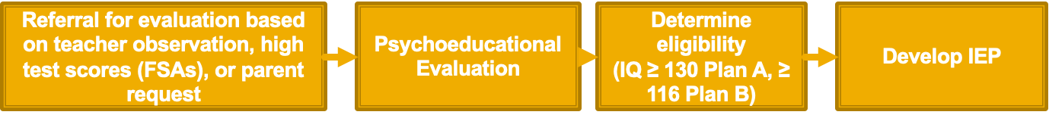
See: http://www.fldoe.org/core/fileparse.php/7690/urlt/ESEGifted17English.pdf
https://forms.dadeschools.net/webpdf/7082.pdf
Brodar

Slide 102

“Gifted and talented” programs inequitably provide access to educational resources
•K-12 participation in gifted and talented programs (2012 data):
•7.6% of White students
•4.6% of Hispanic students
•3.6% of Black students
•1.8% of English language learners
•Disparities persist despite changing eligibility criteria
•Likely because youth from underrepresented backgrounds are less likely to be referred for evaluation
Brodar

Slide 103
Introduction of universal screening program in Broward County Schools provided natural experiment
•Starting in 2005, all 2nd graders completed the Naglieri Non-Verbal Ability Test
•Score ≥ 130 (or 116 for Plan B Eligible) referred for full evaluation with district psychologists
•Students could also still be nominated by parents or teachers
•Referred students placed in queue for testing OR parents could obtain testing outside of district to bypass the queue (e.g., at UM PSC, evals = $1,100)
•No other program changes
•Analysis of student records
•Pre/post differences
•Interrupted time series
•Compared “compliers” (newly-identified gifted students) versus “always takers” (those identified by traditional system)
•Compared the district to others in the state
Brodar

Slide 104
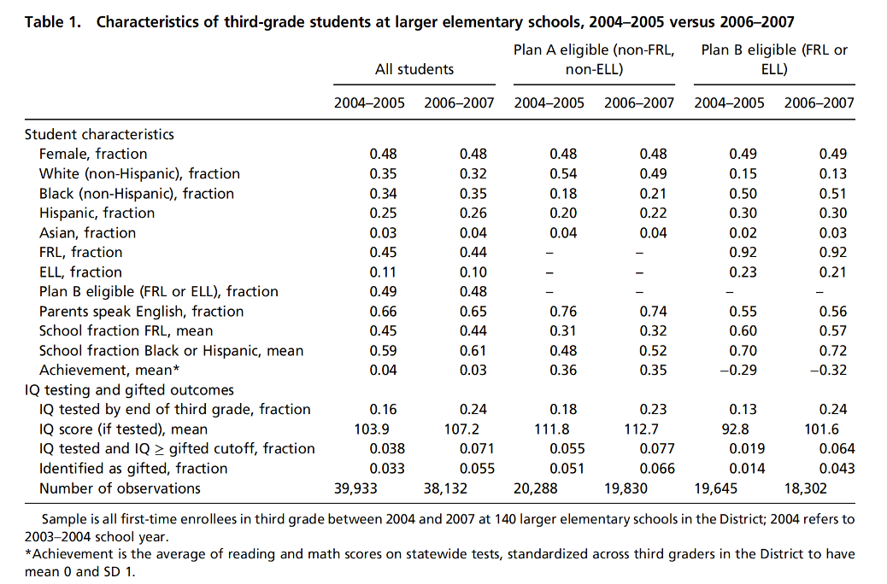
Black & Hispanic students over-represented in Plan B,
Plan B less likely to have IQ scores on record & be classified as gifted
Brodar, Mendez

Slide 105
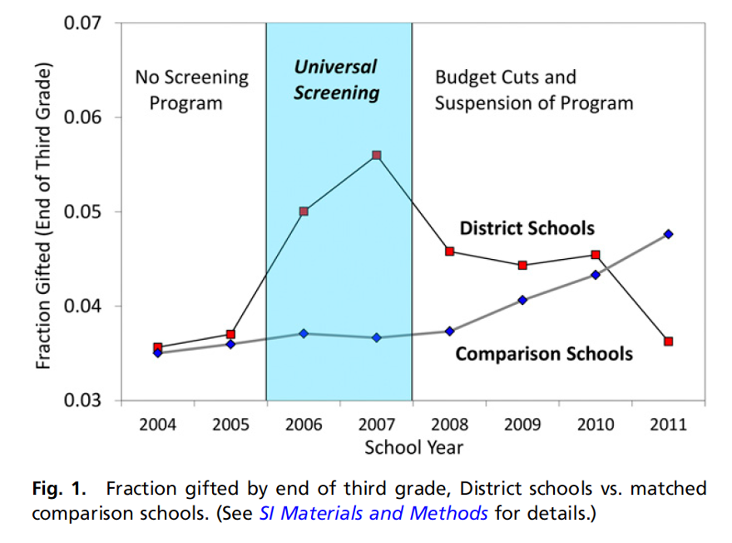
Screening program led to large increases in the fraction of students classified as gifted
Brodar

Slide 106

Change in fraction of students identified as gifted can be attributed to screening given small year-to-year variability in comparable districts
Brodar

Slide 107

Screening had particularly large & positive impact for Black, Hispanic, and Plan B Eligible kids
Overall, universal screening led to 45% increase in odds of being identified as gifted
Brodar

Slide 108


Universal screening made a bigger difference for Plan B students and Hispanic and Black students
Mendez

Slide 109

Traditional referral system misses disadvantaged students, regardless of their cognitive abilities
Brodar

Slide 110

Distribution of IQ scores was similar under old and new procedures, especially for those who qualified under Plan B
Brodar

Slide 111

Screening program led to more equal distribution of students classified as gifted across schools
Brodar

Slide 112

Conclusions: The traditional parent/teacher referral system for gifted education systematically disadvantages kids from Black, Hispanic, ELL, and low-income backgrounds. Universal screening promotes equity and should be (consistently) funded.
Brodar

Slide 113
Discussion questions
What problems might there be with teachers in classrooms screening their students?
Any other problems with this universal screening process?
This program was discontinued due to “budget cuts.” How can we show the government that this is important?
Is there a study or analysis that would be helpful? What do we need to know?
Mendez

Slide 115
Notes:
Study examining disparities of representation of low SES and minority students in gifted education
Change in process for identifying gifted students (parent/teacher referral → universal 2nd grade screening
Increases in lower SES and minority students in gifted

Slide 116
See: http://www.fldoe.org/core/fileparse.php/7690/urlt/ESEGifted17English.pdf
https://forms.dadeschools.net/webpdf/7082.pdf
**What potential barriers can you identify with this process?**

Slide 117
“Gifted and talented” programs inequitably provide access to educational resources
•K-12 participation in gifted and talented programs (2012 data):
•7.6% of White students
•4.6% of Hispanic students
•3.6% of Black students
•1.8% of English language learners
•Disparities persist despite changing eligibility criteria
•Likely because youth from underrepresented backgrounds are less likely to be referred for evaluation
Notes:
- IQ 130 for gifted (116 for ELL or FRL- free/reduced-price lunch)

Slide 118
Introduction of universal screening program in Broward County Schools provided natural experiment
•Starting in 2005, all 2nd graders completed the Naglieri Non-Verbal Ability Test
•Score ≥ 130 (or 116 for Plan B Eligible) referred for full evaluation with district psychologists
•Students could also still be nominated by parents or teachers
•Referred students placed in queue for testing OR parents could obtain testing outside of district to bypass the queue (e.g., at UM PSC, evals = $1,100)
•No other program changes
•Analysis of student records
•Pre/post differences
•Interrupted time series
•Compared “compliers” (newly-identified gifted students) versus “always takers” (those identified by traditional system)
•Compared the district to others in the state
Notes:
Naglieri Non-Verbal Ability Test (NNAT), a nonverbal test intended to assess cognitive ability independent of linguistic and cultural background (M = 100, SD = 15)
Less than an hour to complete, administered by teachers in classroom

Slide 119
Black & Hispanic students over-represented in Plan B,
Plan B less likely to have IQ scores on record & be classified as gifted
Notes:
Characteristics
Plan A mainly white and Asian
Plan B mainly Blacks and Hispanics; more likely to have non-English speaking parents, lower academic achievement
IQ testing and gifted
Plan B less likely to have IQ score on record or be classified as gifted
Pre and post identified as gifted and amount tested increased due to screening
Overall fraction increase by 8%
Many more tested in Plan B eligible
Overall increase in IQs in gifted and identified as gifted
Larger increase in Plan B eligible students

Slide 120
Screening program led to large increases in the fraction of students classified as gifted
Notes:
Increased awareness by teachers does not explain increase in gifted rates after start of program
Universal screening --> increase in gifted number in 3rd grade
2007 cut funding for recession
2010 screening program suspended
2011 return to 04-05 numbers vs gradual program changes in other districts

Slide 121
Change in fraction of students identified as gifted can be attributed to screening given small year-to-year variability in comparable districts
Notes:
Potential district-wide factors impacting gifted rates → empirical distribution of changes in 3rd grade gifted rate from 04/05 to 06/07 for 23 larger districts in Florida that didn’t adopt screening program
Among other larger districts variability b/w pre and post is small
Change in fraction gifted in “the district” is an outlier

Slide 122
Screening had particularly large & positive impact for Black, Hispanic, and Plan B Eligible kids
Overall, universal screening led to 45% increase in odds of being identified as gifted
Notes:
Comparison to other comparable non-charter schools similar to those in the district
Estimate the impact of screening program on gifted participation rates
Pre/post difference rates comparing to other schools
Models:
1: difference-in-difference estimates comparing the district to other schools
3: odds ratio
45% increase in odds of being identified as gifted
Plan B students: 1174% increase in odds of being identified as gifted
Plan A: 11% increase
Blacks: 74% increase
Hispanics: 118% increase
Whites: 12% increase

Slide 123
Universal screening made a bigger difference for Plan B students and Hispanic and Black students

Slide 124
Traditional referral system misses disadvantaged students, regardless of their cognitive abilities
Notes:
Comparing newly identified gifted students to those that would have been identified as gifted already (pre: always takers, post: both, compliers: only newly identified)
Difference compliers to always takers: differences in mean characteristics of compliers and always takers
80% of compliers Plan B eligible
Black (23% compliers vs 12%), Hispanich (46% compliers vs 16%), less likely to be white (8% vs 61%) or English-speaking parents (29% vs 74%), attend schools with higher fractions of FRL participants/non-white, more likely female
Final Column: estimated differences in complier vs always taker
Estimates from Black (0.12) and Hispanic (0.30) sig differ from white -0.53
Compliers have 0.4 SD units lower 3rd grade test scores and IQ scores 0.5 SD lower
Plan B only analyses to account for lower IQ threshold
Similar to overall complier group
More likely to be hispanic and less likely to have parents who speak English
Plan B: lower achievement scores but about same mean IQs
Traditional referral system misses disadvantaged students with modest achievement levels regardless of cog. Abilities

Slide 125
Distribution of IQ scores was similar under old and new procedures, especially for those who qualified under Plan B
Notes:
Distributions in 2006/2007
Plan A
30% compliers IQ <125
Plan B at time of testing and Plan A in 3rd grade
Catching others in Plan A that were not initially caught above 130 IQ
Plan B
Similar distributions, compliers somewhat less likely to have scores close to 116 cutoff
20% of compliers with 130+ IQs
**many children potentially being overlooked**

Slide 126
Screening program led to more equal distribution of students classified as gifted across schools
Notes:
Unequal distribution of gifted students
Blue: pre screening (always takers)
Green: screening → more equal distribution of gifted students across schools
Red: post screening (both) → distribution of compliers across schools → below line → compliers likely to come from schools with low proportions of gifted students in pre

Slide 127
Conclusions: The traditional parent/teacher referral system for gifted education systematically disadvantages kids from Black, Hispanic, ELL, and low-income backgrounds. Universal screening promotes equity and should be (consistently) funded.
Notes:
referral processes by which students are nominated for gifted evaluation tend to systematically miss many qualified minorities and economically disadvantaged students
the screening program led to a 174% increase in the odds of being identified as gifted among all disadvantaged students, with a 118% increase for Hispanics and a 74% increase for Blacks
New screening catches more students who are: Black, Hispanic, FRL, ELL, girls, poorer neighborhoods, schools with less
Compliers: same IQ scores but maybe lower achievement scores
Language potentially an additional barrier

Slide 128
Discussion questions
What problems might there be with teachers in classrooms screening their students?
Any other problems with this universal screening process?
What additional avenues apart from screening are there to address these disparities particularly when not evident in academic achievement (e.g., improve intercultural competence)?
Does testing help protect for biases in any ways?
How do you think this similarly impacts rate of students with LDs?
Thoughts on gifted programs as a whole?
This program was discontinued due to “budget cuts.” How can we show the government that this is important?

Slide 129
Classroom context effects

Slide 130
Relative influence of child & classroom characteristics
Preschoolers sensitive to contextual influences on social interaction skills
Adaptive outcomes depend on goodness-of-fit between child characteristics and context
Child characteristics
Age
Gender
Ethnicity
Ethnic match
Language match
Classroom characteristics
Classroom diversity
Entry policy
Howes, C., Sanders, K., & Lee, L. (2008). Entering a new peer group in ethnically and linguistically diverse childcare classrooms. Social Development, 17,
Notes:
Why?
b/c peer skills are still developing (still reliant on scaffolding/support from environment)
The classroom context (nesting of children within classroom, diversity, and entry policy) accounted for more of the variance in both complex play and peer anxiousness ratings than did child characteristics.

Slide 131
Peer Interaction Measures
Revised Peer Play Scale
Peer engagement (parallel, simple social, reciprocal, cooperative, complex social)
Complex play (reciprocal, cooperative, complex social)
Affective Quality of Play
Anxious
Aggressive
Prosocial

Slide 132

Peer Interaction at Entry vs. 6 months
Proportion engaged increase with time
Prosocial increase with time
Proportion engaged increase with time
Notes:
Prosocial increase with time
Ethnicity on behavior ratings; af amer higher aggression; asian amer higher anxiety

Slide 133


More diverse classes → Complex Play increase
particularly if ethnically matched peer present
Notes:
Older changed most in complex play
On average more diverse classes had greater increase, particularly if had an ethnically matched peer

Slide 134

Anxiousness decreases for children who had a peer with shared home language
Younger children decreased more (b/c very high to start with)
Children who had a peer with shared home language had larger decreases
Notes:
Younger children decreased more (b/c very high to start with)
Children who had a peer with shared home language had larger decreases

Slide 135


Aggression
African-Americans had greatest increase in aggression if no ethnically matched peer

